Slide 1
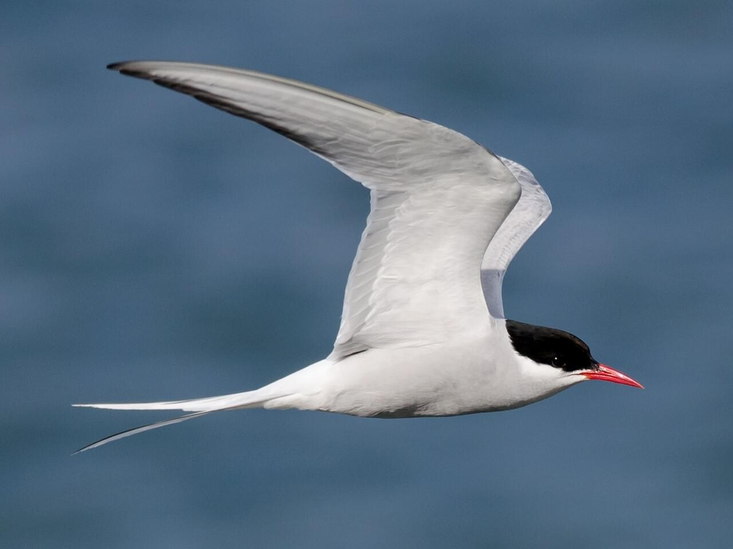
Exploring Arctic Tern Migration
Farrell Sutanto, Nathaniel Zongaro, Stefan Teofilovic, Maximilian Mataija
Notes:
Maximilian mataija

Slide 2
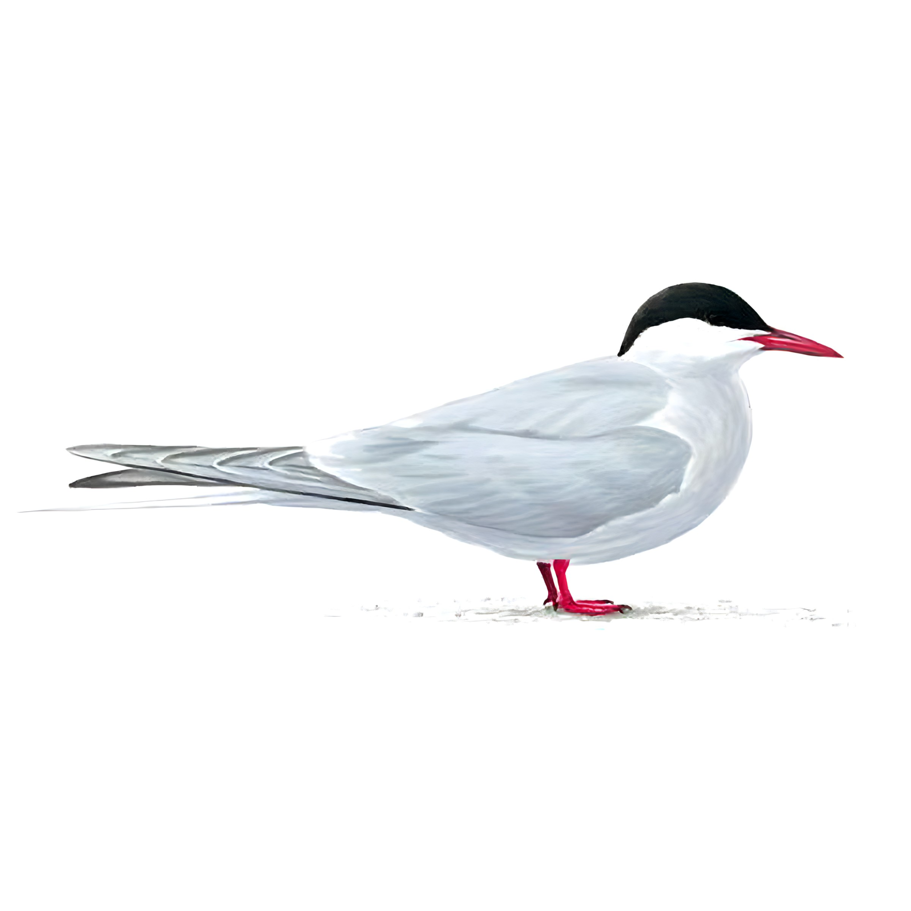
Background
We want to explore how bird migration responds to climate change.
Arctic tern is a migratory species of bird who reproduces during the summers of Subarctic Canada, a region vulnerable to climate change (Walsh et al., 2012)
Walsh, J.E., Overland, J.E., Groisman, P.Y, Rudolf, B. (2012). Ongoing Climate Change in the Arctic. AMBIO (40), 6-16. https://doi.org/10.1007/s13280-011-0211-z
Notes:
Given the increase in climate change, we want to see how bird migration respond to climate change.

Slide 3
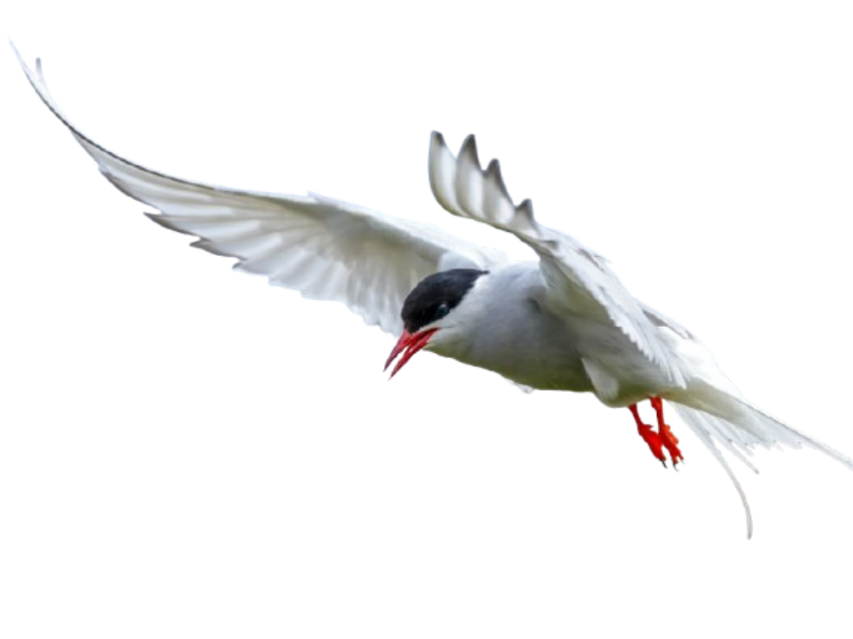

Objectives
To determine whether temperatures in the subarctic are changing overtime
And
Whether Arctic Tern migration patterns are altered with changes in temperature

Slide 4
Hypothesis
We predict that mean temperatures from May to July in the Yukon will rise as we move towards the present.
We also predict that Arctic Tern migration in the spring will occur earlier in the year as temperatures warm in the Arctic.
In years with warmer temperatures in the spring, Arctic Terns will appear in the Arctic earlier in the year.

Slide 5

To Track a Tern: Materials
Tern data collected using Ebird based on observations from 1994 to 2024 in the Yukon.
Data was divided into northern/southern based on assumptions of a non-homogenous landscape and differing migration times.
©Ebird

Slide 6

Materials: Temperature Data
Temperature data collected by weather stations and downloaded using WeatherCan R Package
Stations from Whitehorse were used for southern temperatures, while Inuvik was used as a proxy for the north.
Division of north and south defined as 64.505° N.
LaZerte 2018.

Slide 7
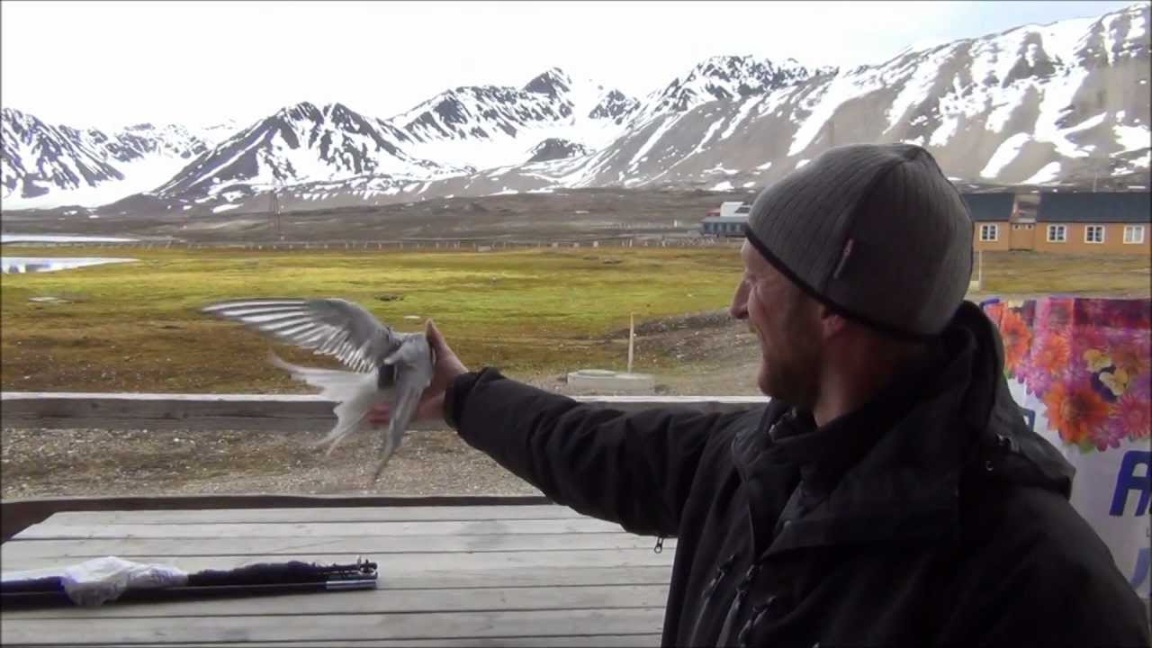
Methods
Migration cutoff date defined as when 50% of total Terns have been observed
Average temperatures between May to July calculated.
Linear mixed-effect models ran for migration cutoff date against average temperatures, observation count, year, and location.
AIC scores, test statistics calculated to look for significance.
Us
Tern Data
©Loonen 2012.

Slide 8
Results - Temperatures vs. Year
North vs. South Random Effect
Parameter | Variance | Variance (control for year)
Intercept | 1.630 | 0.559
Slope (year) | 2.855e-07 | 9.787 e-07
Fixed Effect of Year
Parameter | Estimate | t-value | p-value
Intercept | -84.17064 | -2.352 | 0.0225 *
Slope (year) | 0.04717 | 2.648 | 0.0107 *
Warming about the same rate in north and south, significantly.

Slide 9
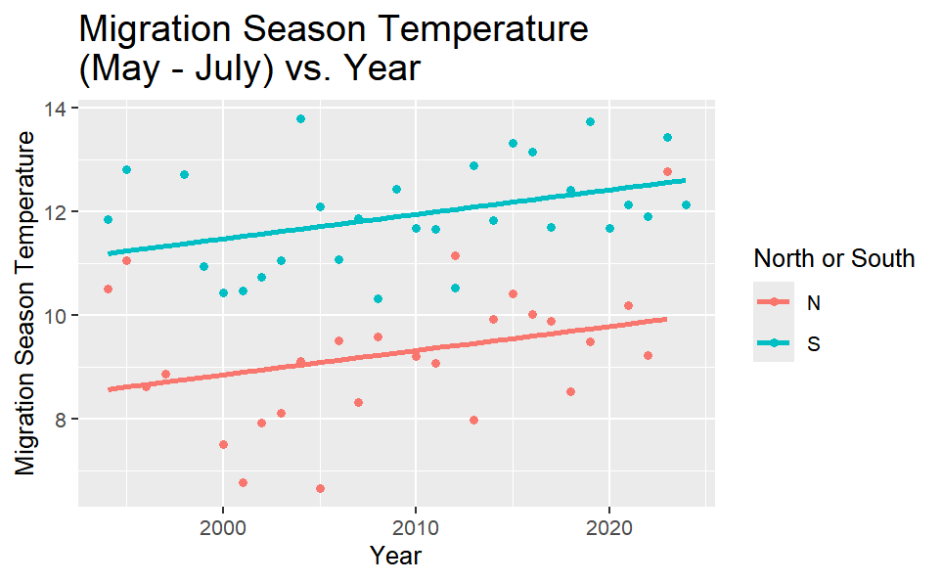
Results - Temperatures

Slide 10
Results - AIC of Migration Date vs. Temperature
Model | AIC Score
Migration date ~ Temperature + Obs. count + (1 + Temperature + Obs. count | North/south) | 516.4936
Migration date ~ Temperature + (1 + Temperature | North/south) | 504.6383
Migration date ~ Obs. count + (1 + Temperature | North/south) | 529.4717
Best model = one with only temperature and random effect.

Slide 11
Results - Migration Timing vs. Temperature
North vs. South Random Effect
Parameter | Variance | Variance (control for year)
Intercept | 330.86618 | 0.392
Slope (temp.) | 0.04341 | 0.00005
Fixed Effect of Temperature
Parameter | Estimate | t-value | p-value
Intercept | 168.8936 | 5.673 | 0.0407 *
Slope (temp.) | -0.1252 | -0.050 | 0.9606
No significant effect of temperature on migration date.

Slide 12
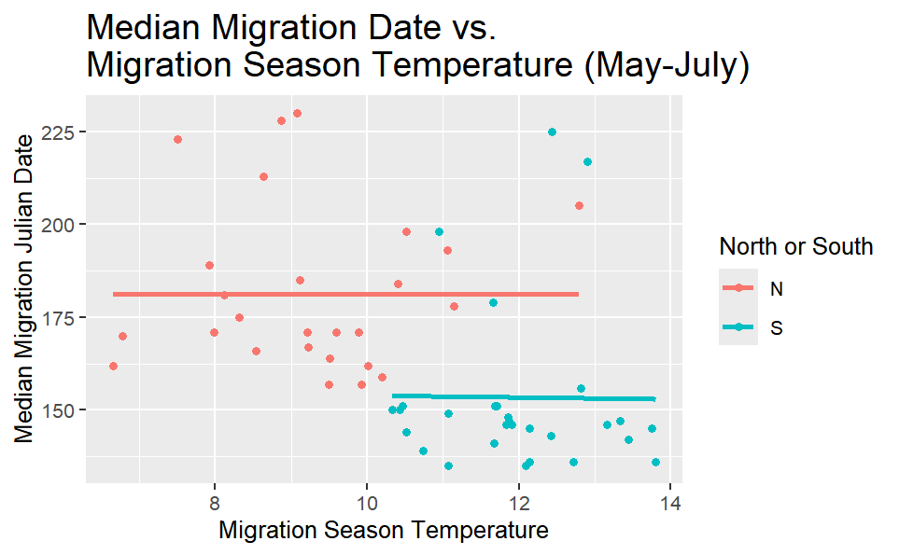
Results - Migration Timing

Slide 13
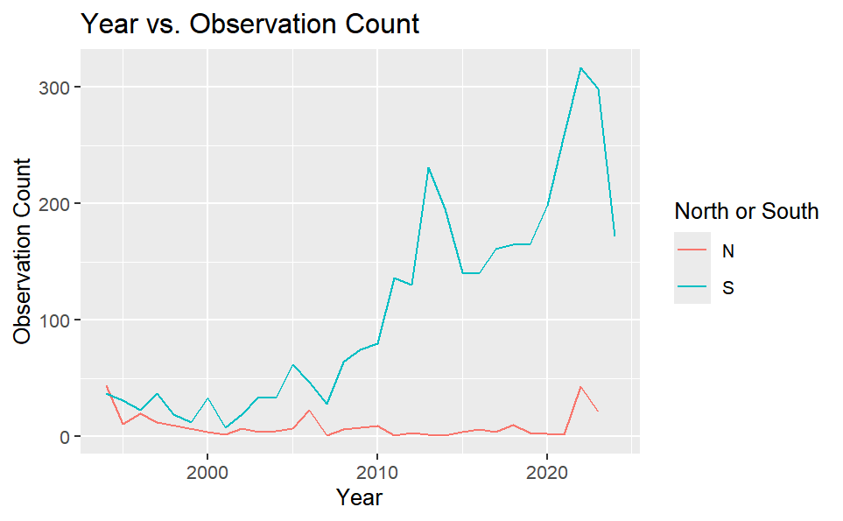
Discussion
Hypothesis Rejected!
There is no significant evidence that changes in temperature alter Arctic Tern migration patterns
What went wrong?
Observation inconsistencies
Arctic Tern abundances through time
Figure. Total number of observations per year at our Yukon sites.

Slide 14
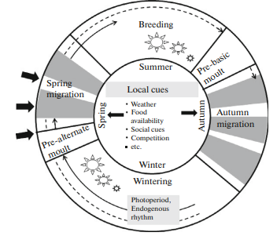
Discussion
What does influence Arctic Tern Migration?
Arctic temperature
Food Availability
Arctic Tern response lag
Daylength + Internal clock
Cornelius et al., 2013

Slide 15
References
Title photo: Alix d’Entremont / Macaulay Library at the Cornell Lab. https://macaulaylibrary.org/asset/249987771
https://allbirdsoftheworld.fandom.com/wiki/Tern?file=Arctic_Tern.png
https://www.rspb.org.uk/birds-and-wildlife/arctic-tern
About eBird - eBird. (n.d.). eBird. https://ebird.org/about
LaZerte, S. (2018). weathercan: An R package for accessing Environment and Climate Change Canada weather data.https://steffilazerte.ca/Presentations/2018-07%20Ag%20Canada%20-%20weathercan/LaZerte_AGCAN_2018_weathercan.pdf
Maarten Loonen. (2012, July 9). catching arctic terns [Video]. Youtube. https://www.youtube.com/watch?app=desktop&v=sdPx5y1NbBo
Sokolov, L. V., and A. L. Tsvey. “Mechanisms controling the timing of spring migration in birds.” Biology Bulletin, vol. 43, no. 9, Dec. 2016, pp. 1148–1160.
Walsh, J.E., Overland, J.E., Groisman, P.Y, Rudolf, B. (2012). Ongoing Climate Change in the Arctic. AMBIO (40), 6-16. https://doi.org/10.1007/s13280-011-0211-z

